Slide 1
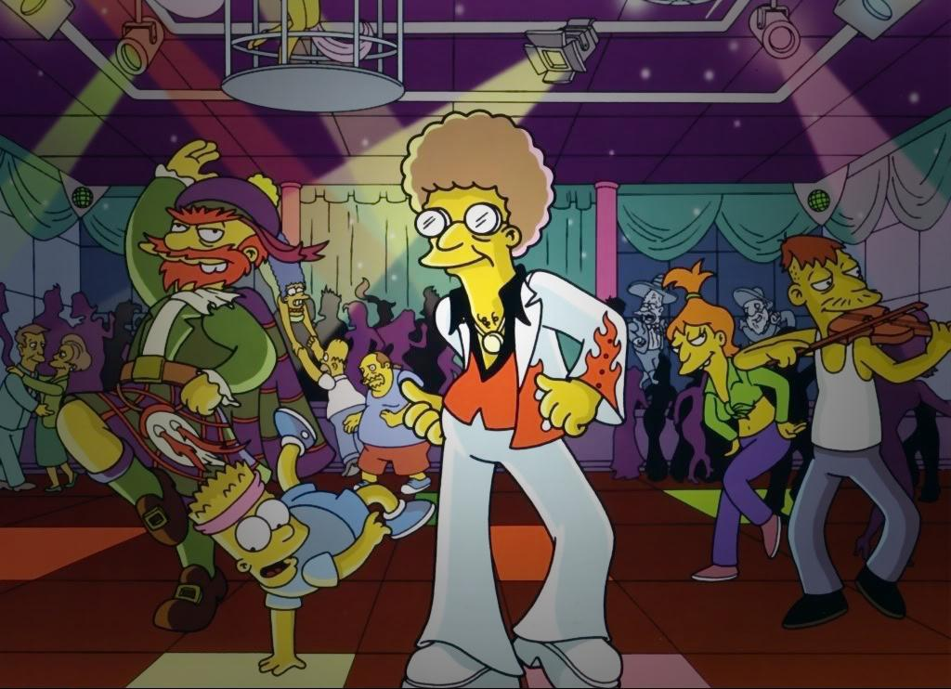
The SoundVisualizer

Slide 2
The idea…
Shader that interacts with a song
The bass – frequency as input to the fragment shader
Value influences the lighting of a disco-room

Slide 3
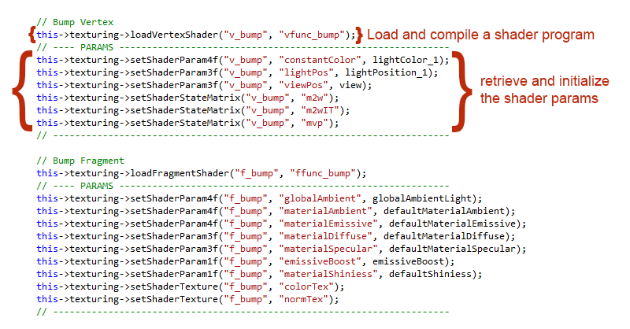
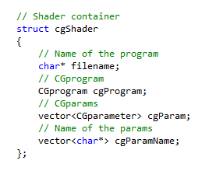
OpenGL - Application

Slide 4
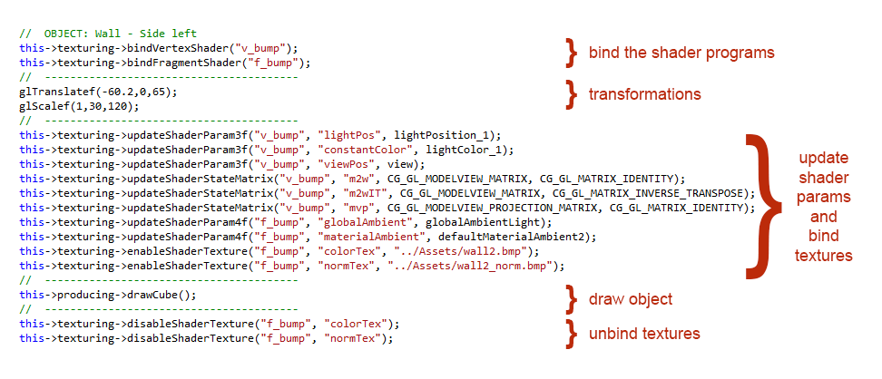
OpenGL - Application

Slide 5
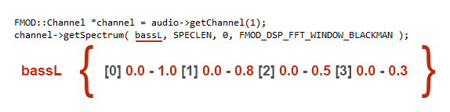
OpenGL - Application

Slide 6
The Floor Shader
VERTEX SHADER:
OUT.color = constantColor;
OUT.texCoord = texCoord;
OUT.lightDir = lightPos;
OUT.viewDir = viewPos;
OUT.position = mul(mvp, float4(position,1));
OUT.positionW = mul(m2w, float4(position,1));
float3 T = cross(normal,float3(1.0,0.0,0.0));
T = normalize(T);
OUT.tangentW = normalize(mul(m2wIT, float4(T,0))).xyz;
OUT.normalW = mul(m2wIT, float4(normal,0)).xyz;
OUT.binormalW = cross(OUT.normalW, OUT.tangentW).xyz,

Slide 7
The Floor Shader
NORMAL MAPPING:
float3x3 tangentMatrix = float3x3( normalize( IN.tangentW ),
normalize( IN.binormalW ),
normalize( IN.normalW ));
float3 normalTex = tex2D(normTex, IN.texCoord).xyz;
float3 normal = normalize(expand(normalTex));
normal = mul(normal,tangentMatrix);
float3 normLight = normalize(IN.lightDir - IN.positionW).xyz;
normLight = expand(normLight);
float3 normView = normalize(IN.viewDir - IN.positionW).xyz;
normView = expand(normView);
float3 normHalfangle = normalize(normLight + normView);

Slide 8
The Floor Shader
COLOR-TILING: for(int x = 0; x <= tiles; x++)
{
for(int y = 0; y <= 2*tiles; y++)
{
if(IN.texCoord.x > x*xFactor && IN.texCoord.x <= (x+1)*xFactor &&
IN.texCoord.y > y*yFactor && IN.texCoord.y <= (y+1)*yFactor)
{
outColor = mixColor[arrCount];
if(counter % 2 == rdm % 2) glow = 1;
}
counter++;
arrCount++;
if(arrCount == 5) arrCount = 0;
}
}

Slide 9
The Floor Shader
SOUND-INTERACTION:
float3 Fcolor = ((outColor + coloredTex * 0.8) * coloredTex) * (soundInput * 5);
float3 Fcolor2 = ((outColor + coloredTex * 0.8) * coloredTex * ((materialEmissive * emissiveBoost) + (materialAmbient * globalAmbient) +
diffuseColor + specularColor));
Fcolor = length(Fcolor2) < length(Fcolor) &&
glow == 1 ? Fcolor : Fcolor2;

Slide 10
Animated Textures
Linear Interpolation:
float2 tex1Coords = float2(IN.texCoord.x + time / 1000,
IN.texCoord.y);
float2 tex2Coords = float2(IN.texCoord.x,
IN.texCoord.y + time / 1000);
float2 tex3Coords = float2(IN.texCoord.x + time / 1000,
IN.texCoord.y + time / 1000);
float4 pureTexture = lerp(tex2D(tex1, tex1Coords),
tex2D(tex2, tex2Coords), soundInput);
pureTexture = lerp(pureTexture, tex2D(tex3, tex3Coords), 0.1);

Slide 11
The Discoball
Vertex Shader:
float3 I = positionW - viewPos;
OUT.R = reflect(I, N);
I = normalize(I);
OUT.TRed = refract(I, N, etaRatio.x);
OUT.TGreen = refract(I, N, etaRatio.y);
OUT.TBlue = refract(I, N, etaRatio.z);
OUT.reflectionFactor = fresnelBias + fresnelScale *
pow(1+ dot(I, N), fresnelPower);

Slide 12
The Discoball
Fragement Shader - Lighting:
float3 Ln = normalize(IN.lightDir);
float3 Nn = normalize(IN.normal);
float diffuseLight = max(dot(Nn, Ln), 0);
float3 diffuse = pureTexture.rgb * diffuseLight.xxx *
IN.lightcolor.xyz;
float3 Vn = normalize(IN.viewDir);
float3 Hn = normalize(Ln + Vn);
float specularLight = pow(max(dot(Nn, Hn), 0), shiniess);
if (diffuseLight <= 0) specularLight = 0;
float3 specular = specularLight.xxx * IN.lightcolor.xyz;

Slide 13
The Discoball
Fragement Shader – Enviroment Mapping:
float4 reflectedColor = texCUBE(environmentMap, IN.R);
float4 refractedColor;
refractedColor.r = texCUBE(environmentMap, IN.TRed).r;
refractedColor.g = texCUBE(environmentMap, IN.TGreen).g;
refractedColor.b = texCUBE(environmentMap, IN.TBlue).b;
refractedColor.a = 1;
float4 environment = lerp(refractedColor, reflectedColor,
IN.reflectionFactor);

Slide 14
The Discoball
Fragement Shader – Tiling:
float4 patternCheck = tex2D(pattern, IN.texCoord);
float glow = 0;
if(patternCheck.r == glow && patternCheck.g == glow && patternCheck.b == glow)
{
float3 a = lerp(diffuse.rgb * (soundInput * 50 + 1) + specular.rgb * (soundInput * 50 + 1) +
materialEmissive.rgb,environment, 0.6);
float3 b = lerp(diffuse.rgb + specular.rgb + materialEmissive.rgb, environment, 0.5);
fragmentOut.rgb = length(a) > length(b) ? a : b;
}else{
fragmentOut.rgb = diffuse.rgb + specular.rgb + materialEmissive.rgb + environment * 0.1;
}
fragmentOut.a = 1

